Slide 1
Introduction to Data Science: Course Overview and Team Introduction
Induction and Introduction

Slide 2
Outline
INTRODUCTION TO DATA SCIENCE WITH PYTHON FOR ENGINEERS AND RESEARCHERS
Introductions
Meet your instructor
Icebreaker survey
Course structure
Course objectives – Intended Learning Outcomes and overall goal
Weekly topics and activities
Assessment
Additional resources

Slide 3
Introductions

Slide 4


Who I am
INTRODUCTION TO DATA SCIENCE WITH PYTHON FOR ENGINEERS AND RESEARCHERS
Currently the Lord Kelvin Adam Smith Research Fellow in Data Science
Based in the School of Geographical and Earth Sciences
Hobbies include surfing, skating and rock climbing

Slide 5


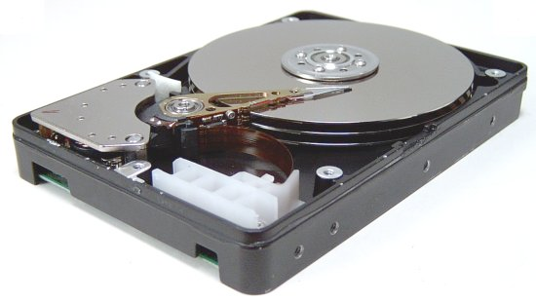

From Device physics to the origin of the solar system
B.P. Weiss - MIT
NASA
What happens when magnetic data gets old? How stable are our magnetic records?
Notes:
In moving to cambridge I have moved away from well characterised samples, where the composition and desired crystallograpic structures are determined in fabrication process.
moving to rock magnetism, I now work on a variety of naturally formed samples, where the composition and crystallographically are generally unknown going into an experiment. Additionally, these samples are heterogenous across multiple length scales. The challenge comes in selecting the correct length sales and measurement data to characterise a sample. or rather connecting the information available at different length scaliest make a coherent story
while the magnetic fields present in the solar system are acting across millions of km, the information about how they change is recorded on nanoscale magnetic structures
Rock magnetic records inform us about when planets form, how the core dynamo of a planet evolves and also have important implications
Data sets are getting bigger and richer… multiple information streams
symplectite map 284 x 260 —> 73840 spectra
Need a tool that allows for statistical robust method for the integration of of data
In particualr for geological systems want a method that identifies mineral phases and allows for the interrogation of the individual phase variations related to solid solutions.
This unlocks how planetary process occur connecting nanoscale to the planet scale.
For examples we will look at sediments collected from the Southern ocean to explore the original providence of the grains observed.
Further, we will demonstrate the full power of
mention development of various mineralogical mapping approaches
also EDAX, Joel and Bruker developing PCA and cluster approaches integrated into the detectors or at least available through the analysis software.
Most of these approaches revolve around defining ROI’s based on BSE contrast and combining with collected spectra.
EDS maps quickly become large data objects, where it is not practical to analyse each spectra individually.
Most common and fastest way to gauge the compositions of a system is EDS mapping
EBSD can segment immediately, but also does not allow to understand important questions related to solid solution end member components.
statistical methods allow for a numerical way to sift through the data.
Here we demonstrate a process where not only we can

Slide 6
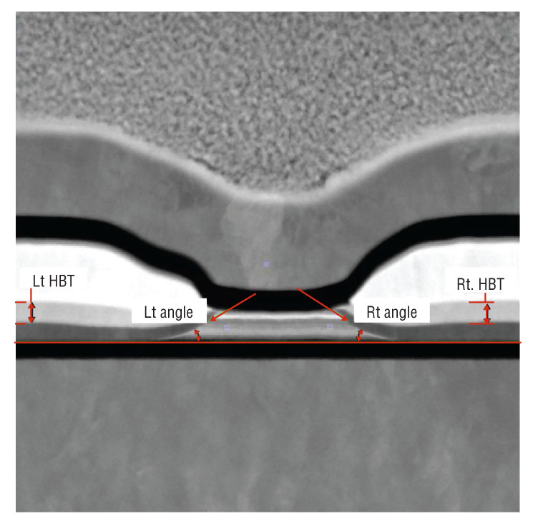
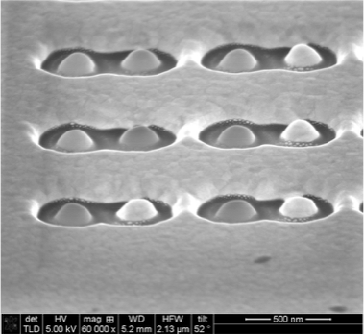
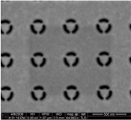
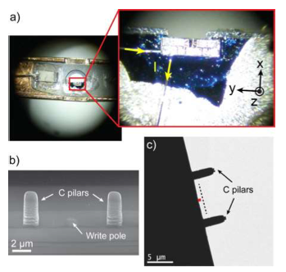
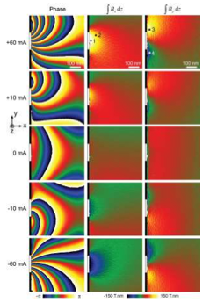
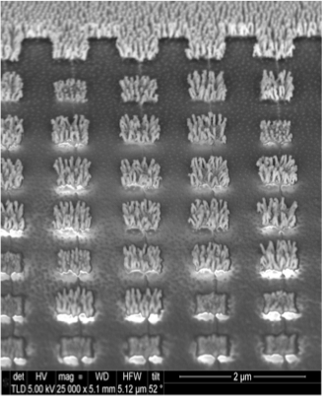
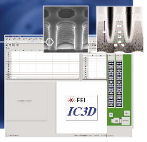
Process Control and Device Physics
Statistical Process Control
In-Situ Holography of Active
Hard Disk Drive Write Pole
FIB Nanofabrication
Wang and Arjavac, 2008
Einsle et al. Nano Research (2015)
Notes:
Metrology Engineer for FEI Comapy at Seagate Technologies Springtown
PhD research in nano fabrication of plasmonic devices
Post-doctoral projects on the in-situ holography of active device fields

Slide 7
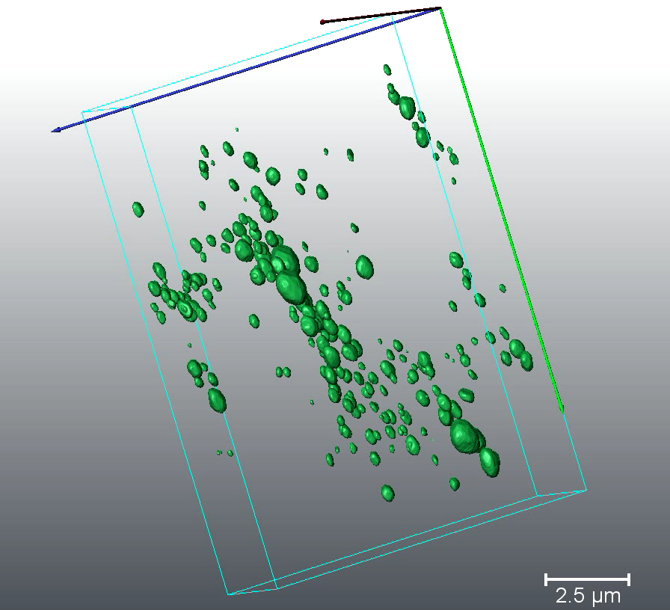
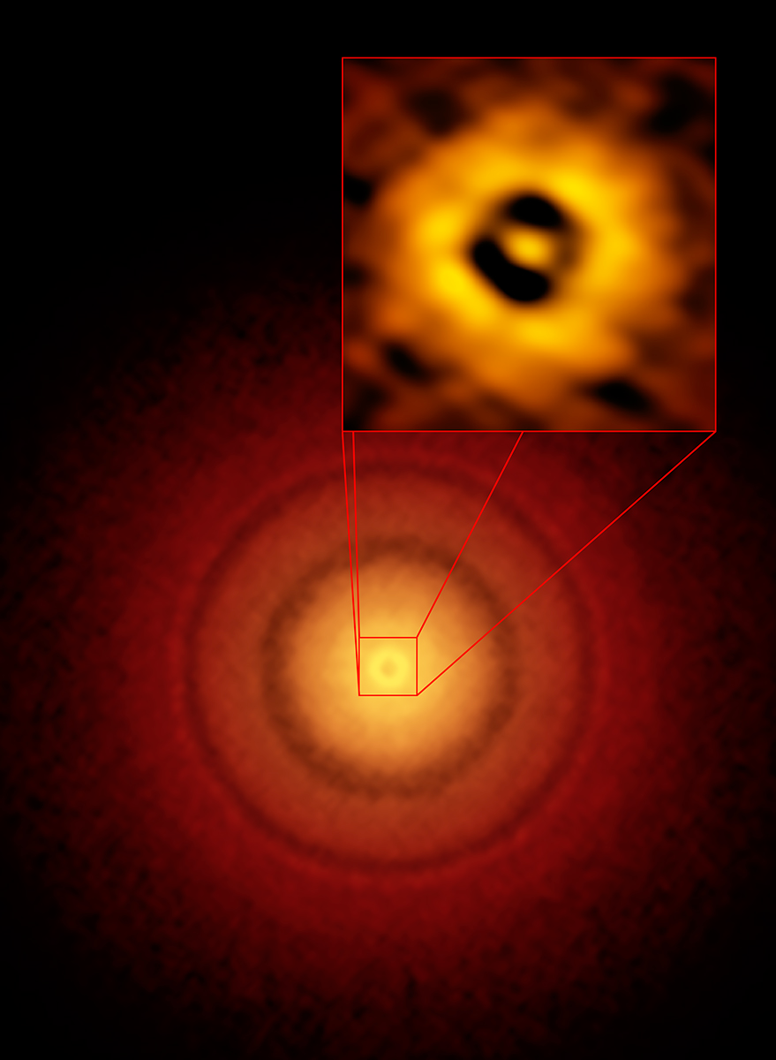
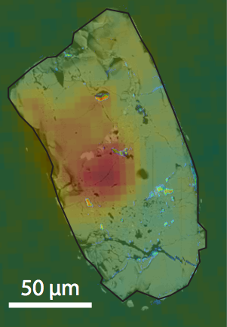
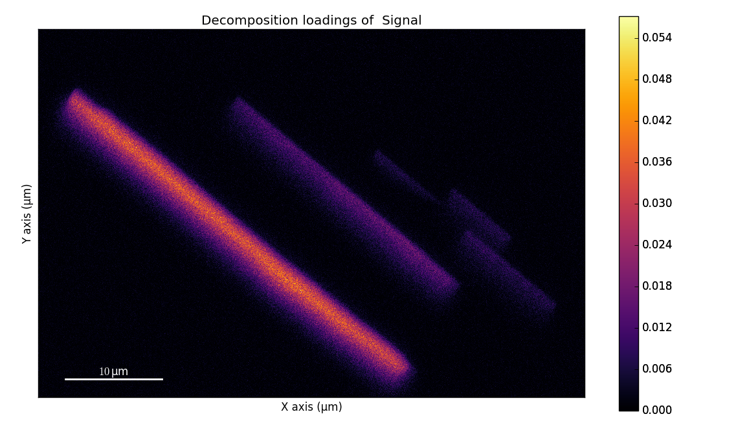
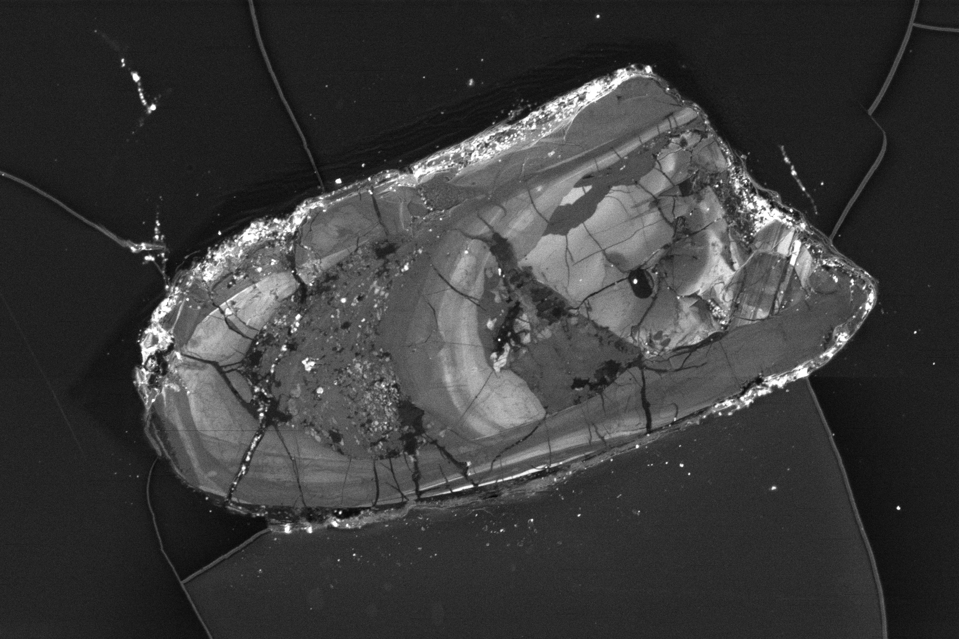
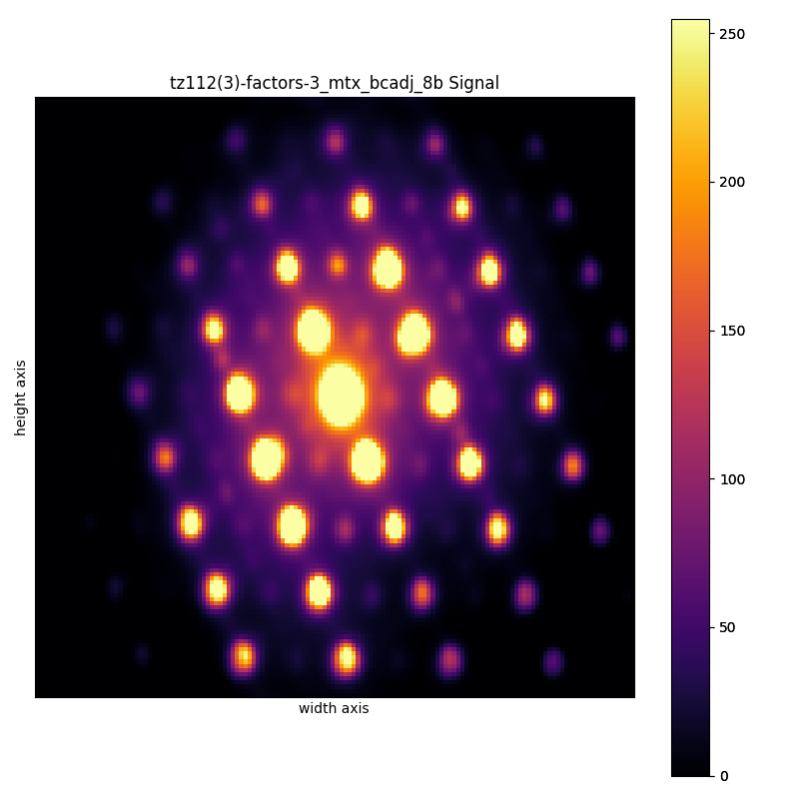
Connecting Materials properties through Deep time
Fidelity of Nebular Magnetic Fields
Mineral limits for Hadean Zircons
Magnetic Records in Differentiated Palentessimals
Nebular Magnetic Fields
Multiscale approach to understanding natural magnetic signals
B.P. Weiss - MIT
ESO
Weiss et al, Geology 2018
How do you maximise the information available in the oldest and rarest materials?
How are we confident in the measurements that we make?
How do bulk measurements directly relate to the nanostructures in a sample?
Magnetic Fields on Small planetary bodies
Introduce need for Machine learning in microanalysis
Notes:
How do you maximise the information available in the oldest and rarest materials?
What are the limitations of single crystal approaches?
How are we confident in the measurements that we make?
anorthite: CaAl- siliacate
augite: (Ca,Na)(Mg,Fe,Al,Ti)(Si,Al)2O6

Slide 8


Course Administrators
Introduction to Data Science with Python for Engineers and Researchers
Rosemary (Rosie) McGovern
Upskilling Course Administrator
Anne Dunlop
Learning & Teaching Administrator (GES)

Slide 9

Getting to Know you - Ice Breaker
Introduction to Data Science with Python for Engineers and Researchers
The link below is to an interactive icebreaker.
These are all short answer and or multiple choice
This is to let me get to know you better and generate a little data that we can use in our first practical.
All data collected is completely anonymous and covered by GDPR
https://www.menti.com/ch2gfr1ihh

Slide 10
Course Structure

Slide 11
Course Objectives - Intended Learning Outcomes
Introduction to Data Science with Python for Engineers and Researchers
By the end of this course students will be able to:
Demonstrate how to use the data structures, functions, and visualization tools in Python (and several dependent libraries) to explore and analyze multivariate data.
Produce summary statistics for exploratory data analysis and multivariate statistical tests.
Employ supervised machine learning algorithms to perform classification and prediction tasks on data sets.
Apply unsupervised machine learning to perform dimensional reduction, data clustering, and categorization on unlabeled high-dimensional data.

Slide 12
The big objective
Introduction to Data Science with Python for Engineers and Researchers
The goal of the course is to teach the theory behind machine learning and make it less mystical, so you are equipped to use it appropriately.​
This course will:
Provide you with a strong foundation in data science and familiarity with statistical tools.
You will learn to use Python as tool for data analysis.
You will learn how to use coding basics to explore data and document your insights with Jupyter notebooks and make informative plots with python tools.
This course is not focused on:
Teach you good coding practice (ie rev control, code optimisation) - but some bits will be covered as a ‘by the way you might want to consider…’
It is not an introduction to coding (you will learn some coding along the way if you have never thought )
We will not build dashboards, applications or how to build virtual machines / environments

Slide 13
Course structure
Week | Topic | Materials Covered
1 | intro to python, data structures and tabular data - moving beyond Excel | Course induction (weekly structure, assessment, introductions) introduction to google colab and jupyter notebooks, beyond spread sheets, introduce Pandas Basic plots.
2 | exploratory data analysis - missing data and summary statistics | manipulating a dataset: missing values, examining the data, summary statistics, scatter plots , 'For loops'
3 | multi-variate statistics -normal distributions and t-tests | exploring normal distributions and using the t-tests for small data populations / non-normal datasets
4 | Multivariate statistics II - ANOVA testing | introduce analysis of variance, hypothesis testing, one and two way ANOVA testing also box plots,
5 | Data wrangling : normalisation and scaling | exploring why need to re-scale and 'manipulate ' data
6 | supervised learning: linear regression | test and train data; least-squares, ridge and lasso
7 | supervised learning: nearest neighbour analysis & final project design | NNA for missing data, work with students on designing their final project
8 | Unsupervised Machine learning: PCA and Factor analysis | high dimensional data and need for dimensional reduction, scree plots, PCA and VARIMAX, heteroscedastic noise, linearity
9 | Unsupervised Machine learning: clustering | k-means clustering, building an unsupervised data pipeline (pre-processing, PCA, clustering)
10 | working on BYOD final project | supervised time to work on final project. And preparing report. Evaluation use the tools presented to figure out a way to create an action for solving a problem

Slide 14
Weekly structure
Introduction to Data Science with Python for Engineers and Researchers
Monday – Lectures for week go live
Tuesday – Live practical data workshop (optional) (6:30 pm to 8:30 pm)
Wednesday – Question and Answer forum closes (10 PM)
Thursday – Live (optional) Question and Answer (7-8 pm)

Slide 15
Types of activities
Introduction to Data Science with Python for Engineers and Researchers
Interactive lectures
Call and response format –
Recorded lecture will demonstrate a concept
then you practice in a pre-formatted notebook
Data Workshop(optional)
Live zoom session presenting an opportunity for further practice of topics covered in lecture using new data
Opportunity to build up a workflow
Weekly Question and Answer (Optional/ live zoom/ recorded)
Provide live discussion of questions submitted on a Moodle forum
Forum Discussions
Reflect on readings, and videos shared on Moodle

Slide 16
Assessment

Slide 17
Assessment
Introduction to Data Science with Python for Engineers and Researchers
2 Summative marked assessments – Data Analysis Project
Both due week 11
5 min video presentation (equivalent to 500 word written report) (30%)
1000-1200 word essay (70%)
2 Formative assessments – ungraded/ Generic Feedback
Week 3 – Short answer document on what is the most common type of data that you deal with? How can machine learning help?
Week 7 – Present a video proposal of what your project is. Voice over power point, 3 slides.

Slide 18
The Final Project (Summative Assessment)
Introduction to Data Science with Python for Engineers and Researchers
Objective is to gain insight about a complex problem by leveraging 'large data'
Here large can mean lots of data or it can mean high dimensional or both.
That said between the constraints of Google Colab and what we cover in the course I would not expect anything more than a few GB in size.
You should use informative visualisation tools to demonstrate the insights derived, and the steps used to pre-process and analyse your data.
Ideally the dataset should come from your place of work, but if not there are multiple open datasets that would be suitable.
The two formative assessments are designed to get you thinking about what you will do for your project.

Slide 19
Further Resources (topic specific)
Introduction to Data Science with Python for Engineers and Researchers
This is a masters level course. As such you should engage with the research and professional literature around the topics. It is also a rapidly expanding and changing field with new tools constantly being produced. Two great books to reference and start your reading would be:
‘Hands on Machine Learning with Scikit-Learn and TensorFlow’ by Aurélien Géron. (O'Reilly)
‘Effective Pandas’ by Matt Harrison.
Both are selected for there practical approach to the topics and provide a great reference to some of the ideas that we will cover over the coming weeks. Also useful for plotting data is:
‘Scientific Visualization: Python + Matplotlib’ by Nicolas P. Rougier (https://github.com/rougier/scientific-visualization-book)

